Slide 1
LECTURE#01 INTRODUCTION TO SITE PLANNING AND LANDSCAPE DESIGN

Slide 2
WHAT IS SITE PLANNING?
Buildings
Roads
Walkway
Trees, garden, pool (landscape)
Water
Plaza
Pier
environment
Etc.
©iStockphoto.com

Slide 3
What is SITE PLANNING?
Site planning is the art and science of arranging the structures on the land and shaping the spaces between, an arts of arranging uses of land linked to architecture, engineering, landscape architecture, and city planning.
Site plans locate objects and activities in space and time. These plans may concern a small cluster of houses, a single building and its grounds, or something as extensive as a small community built in a single operation. (Kevin Lynch, Gary Hack; Site Planning, MIT press, Cambridge 1996)
©iStockphoto.com

Slide 4
Continued......
Site planning is the organization of the external physical environment to accommodate human behavior. It deals with the qualities and locations of structures, land, activities and living things.
Site planning is professionally exercised directly by landscape architects, but there are related profession involved which are architects, urban and regional planners, engineers.

Slide 5
Related Professions
Urban Planning
Landscape
architecture
Architecture
Site planning
Civil
engineering

Slide 6
What Site PLANNERS DO?
Site Planners designate the uses of land in detail by:
Selecting and analyzing sites,
Forming land use plans,
Organizing vehicular and pedestrian circulation,
Designing visual form and materials concepts,
Readjusting the existing landforms,
Providing proper drainage,
And finally developing the construction details necessary to carry out their projects.

Slide 7
What is meant by a Landscape?
Landscape can be defined as all the visible features of an area of land, often considered in terms of their aesthetic appeal.
Landscaping refers to any activity that modifies the visible features of an area of land.
Landscape has six main compositional elements:
Landform
Vertical Structures
Horizontal Structures
Vegetation
Water
Climate
©iStockphoto.com

Slide 8
Landscape Design
Landscape Design is the art of arranging all the above mentioned elements in order to make a good outdoor space.
In other words, Landscape design is the analysis, planning, and design of exterior living spaces.
Landscape design today integrates a wide variety of elements to achieve functional and beautiful spaces for outdoor living.
Landscape Elements include both natural (Plants/vegetation, water, landforms, timber, stone) and manmade elements (Brick, metal, glass,etc)

Slide 11
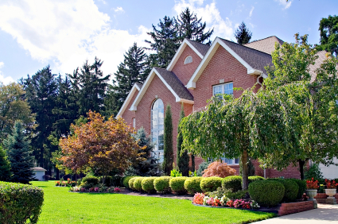
Landscape Value Determinants
Good design results in adding value to property and enhancing quality of life.
Aesthetic appeal
Economic value
Functional value
Environmental effects
©iStockphoto.com

Slide 12
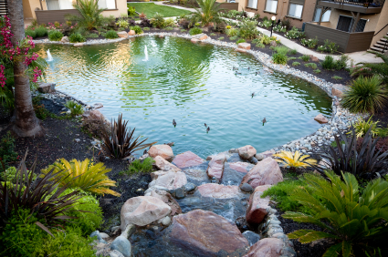
Aesthetic Appeal
Add visual beauty
Hide undesirable features
Emphasize desirable features
Appeal to all five senses
Sight
Hearing
Touch
Taste
Smell
©iStockphoto.com

Slide 13
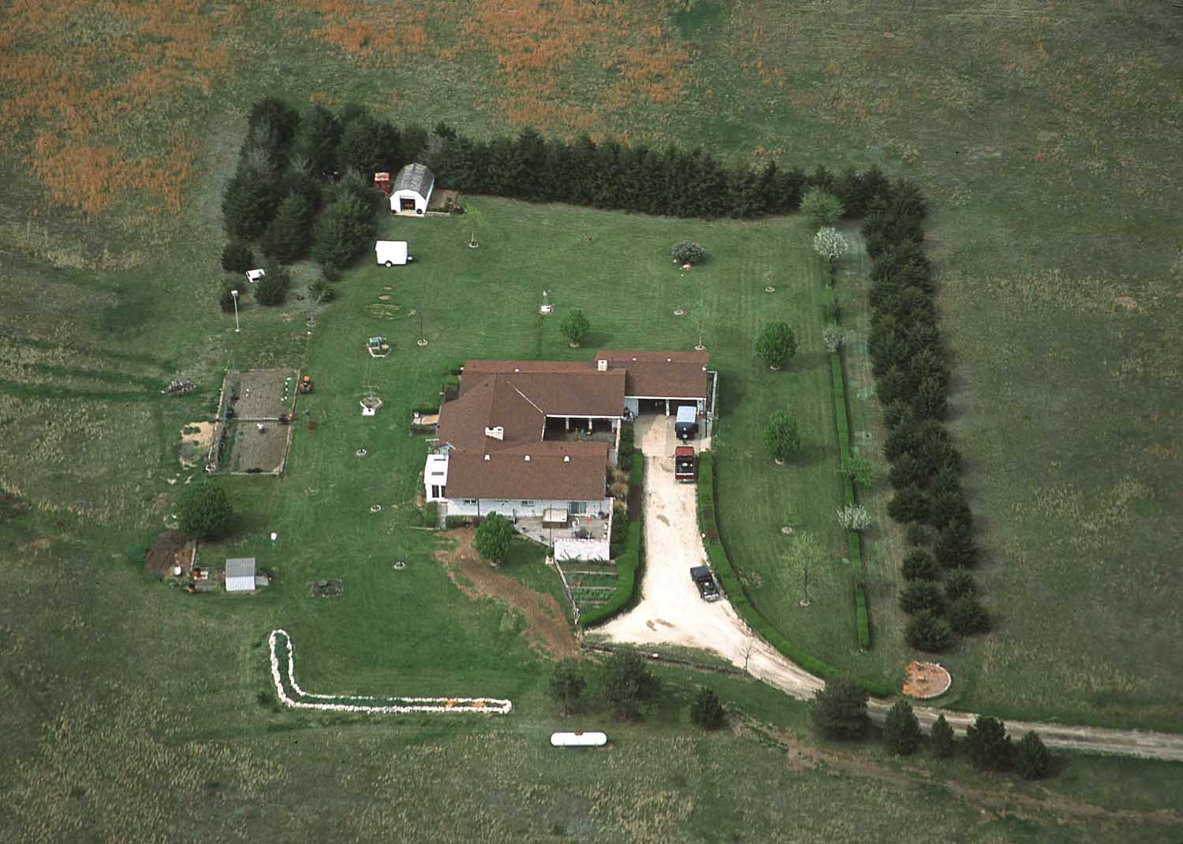
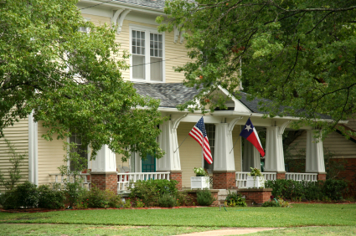
Economic Value
Increase property value 6 to 15 percent
Reduce energy costs
Buffer wind
Control solar heat gain
Courtesy USDA
©iStockphoto.com
Notes:
Planting trees and shrubs strategically can reduce energy costs by sheltering a structure from cold winter winds (as shown in the image on the left) or shading a structure and pavement from the hot summer sun (as shown in the image on the right).

Slide 14
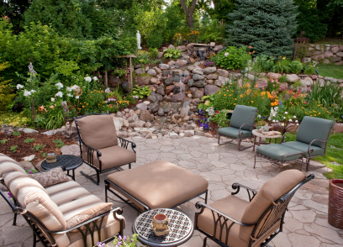
Functional Value
Aesthetic value
Enhance livability
Conservation and environmental protection
Solar heat control
Wind control
Sound control
©iStockphoto.com

Slide 15
Environmental Effects
©iStockphoto.com
Landscaping can
Moderate temperatures
Reduce glare and wind
Use water more efficiently
Clean the air
Provide wildlife habitat
Bird and Butterfly habitat

